Slide 1

A data-driven exploration of Emission trends and Climate Trajectories
Cristian Sayers

Slide 2
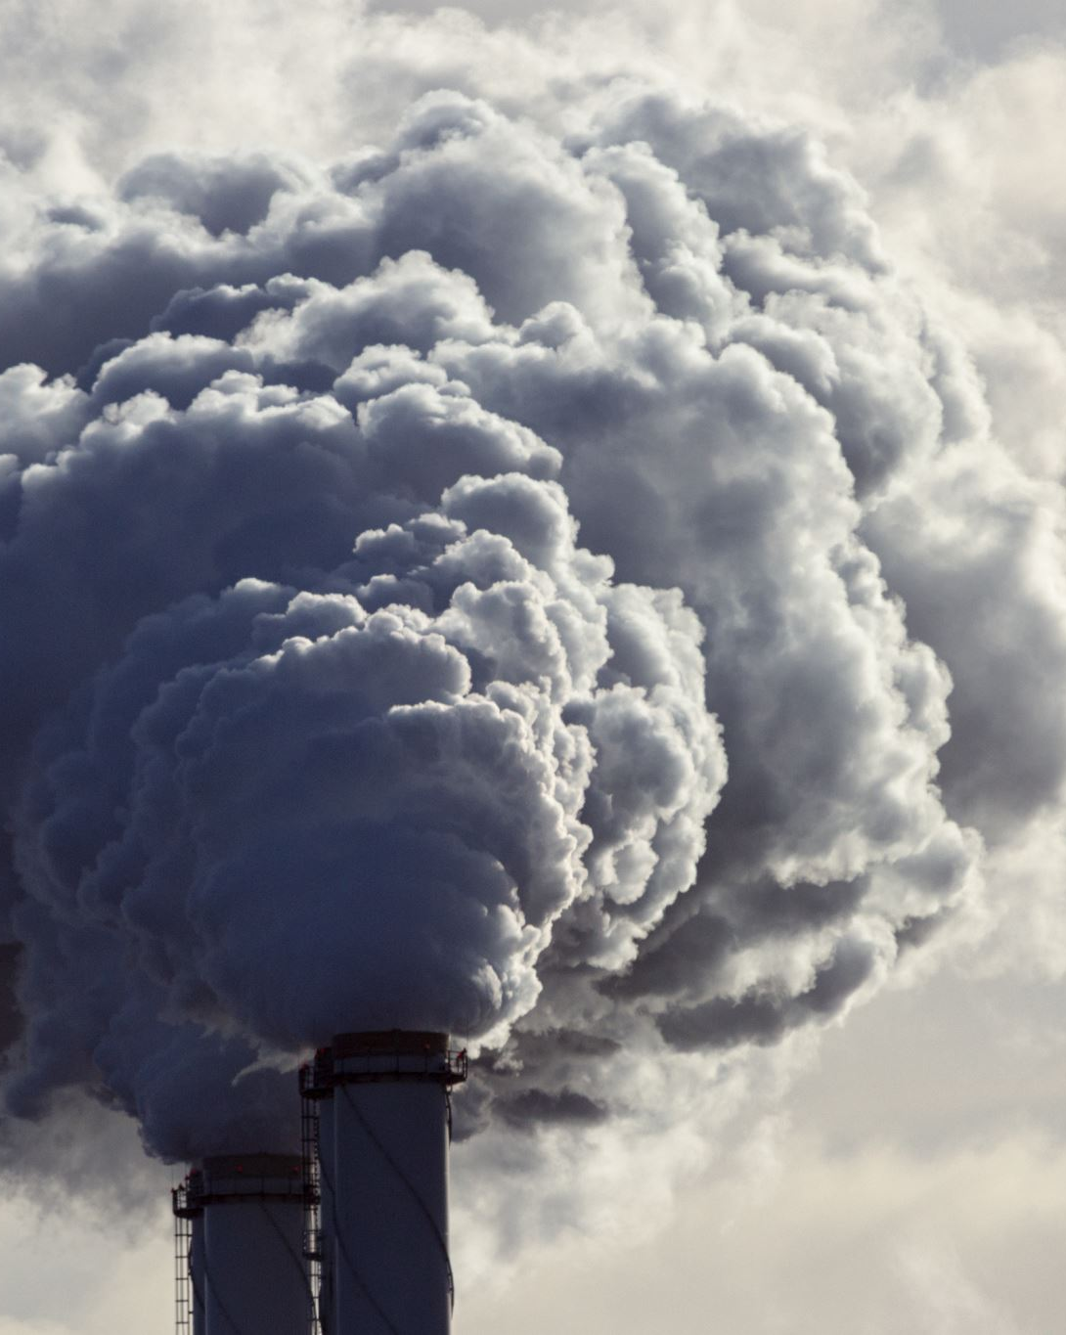
Goals
To show the relationship between carbon dioxide emissions and multiple variables to better our understanding of the effects of these emissions.
This includes carbon dioxide and temperature, where past and future projections will be compared against carbon dioxide emissions. The future projections will consist of three scenarios of varying socio-economic progress.
Furthermore, the relationship between GDP and Population of high emission countries with carbon dioxide emissions will be assessed. This will be supplemented with a visualization explaining the development of renewable energy sources over time compared with emissions to round off the economic variables.

Slide 3

Goals
The assessment of environmental variables against carbon dioxide emissions will be assessed to attempt to discover patterns between events. This will include deforestation data and extreme weather event frequency.
The culmination of the data presented will involve assessing whether the Paris Climate Agreement has been effective since its enactment in late 2016.

Slide 4
Summary of Findings
Found relationships of increasing temperature because of increasing carbon dioxide emissions over time and into the future.
Found a correlation between large population and GDP with emissions magnitude.
Found a direct effect of emissions on weather event frequency and high carbon dioxide emissions in regions of high tree cover loss.

